Slide 1
LISTS

Slide 2
Agenda
What is list and Getting list
List are mutable
Traversing a list
List operations
List slices
List methods
List lambda,map filter and reduce
Deleting elements
Lists and Strings

Slide 3
What is list and Getting list
List:List contain items of different data types. Lists are mutable i.e., modifiable.
The values stored in List are separated by commas(,) and enclosed within a square brackets([]). We can store different type of data in a List.
Value stored in a List can be retrieved using the slice operator([] and [:]).
The plus sign (+) is the list concatenation and asterisk(*) is the repetition operator.

Slide 4
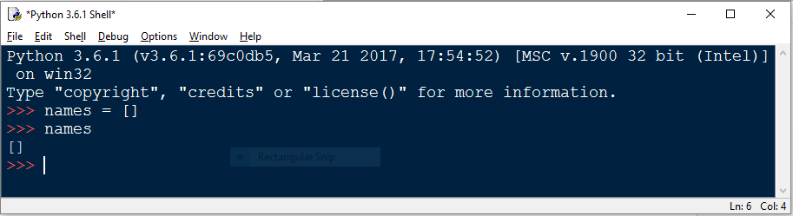
How to create a list
In Python programming, a list is created by placing all the items (elements) inside a square bracket [ ], separated by commas.
It can have any number of items and they may be of different types (integer, float, string etc.).
Example1: Empty List

Slide 5
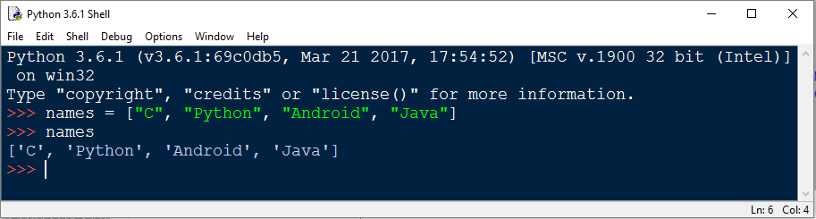
Non-Empty List
The above example is a non empty list because we did passed some values in list.
a term called index in a python for list which indicates the position of the value in the list. List having two types of index are there i.e.,
1. Forward index: When index starts from 0 then values displaying from left to right.
Ex: 0, 1, 2, 3, 4…
2. Backward index: When index starts from -1 then values displaying from right to left.
Ex: -1, -2, -3, -4, ………..

Slide 6
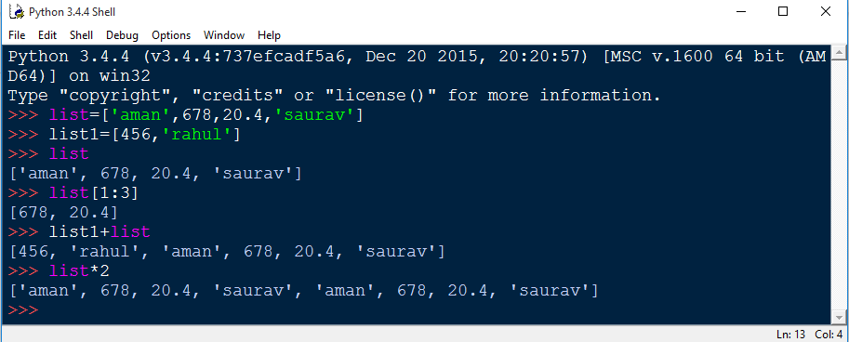
Continue……..

Slide 7
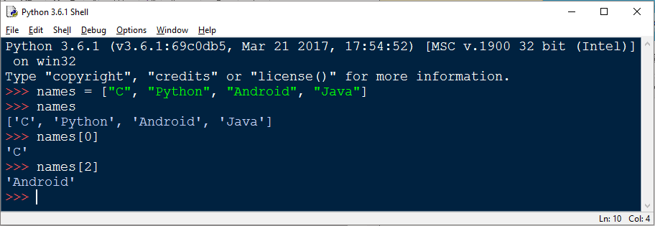
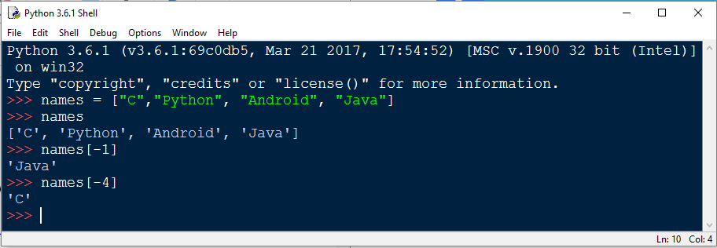
Forward and backward index

Slide 8
List are Mutable
Types of list: List is divided into two types
a. Mutable list
b. Immutable list
Mutable list: A mutable object can be changed after creating a list. Different languages have different policies on whether string should be mutable. Ruby has mutable.

Slide 9
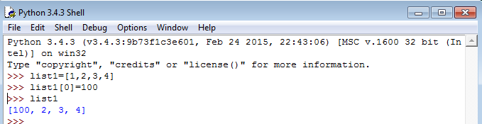
Mutable list
When coming to python list are mutable i.e., python will not create a new list but we modify an element in the list.

Slide 10
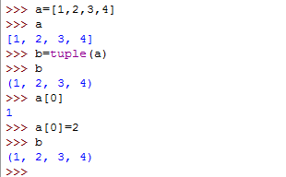
Immutable list
Immutable list: Instance of this ImmutableList class can be used anywhere a normal python list is expected.

Slide 11
Traversing a List
A lot of computations involve processing a sequence one element at a time. The most common pattern is to start at the beginning, select each element in turn, do something to it, and continue until the end. This pattern of processing is called a traversal.

Slide 12
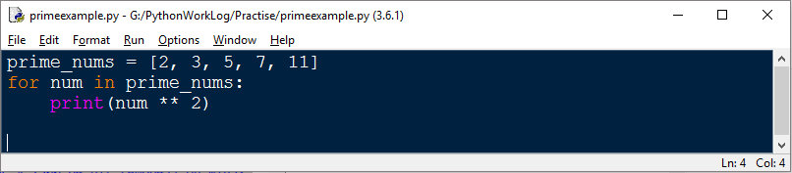
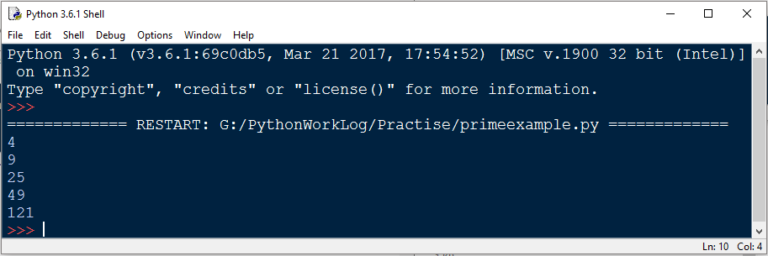
Example

Slide 13
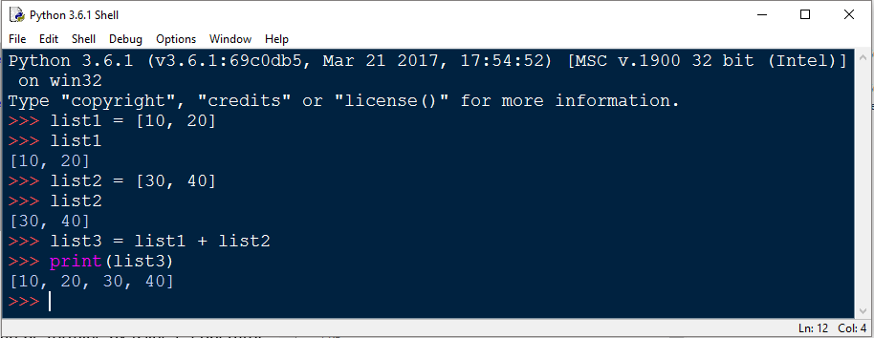
List Operations
a) Adding Lists: Lists can be added by using the concatenation operator (+) to join two lists.

Slide 14
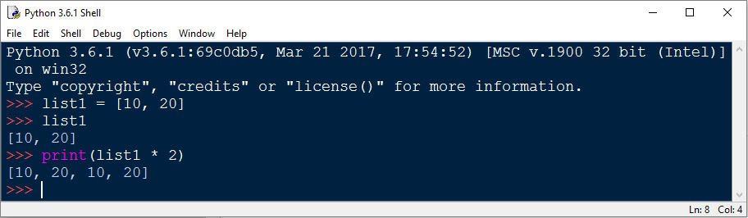
Replicating Lists
b) Replicating Lists: Replicating means repeating. It can be forming by using (*) operator by specific number of time.

Slide 15
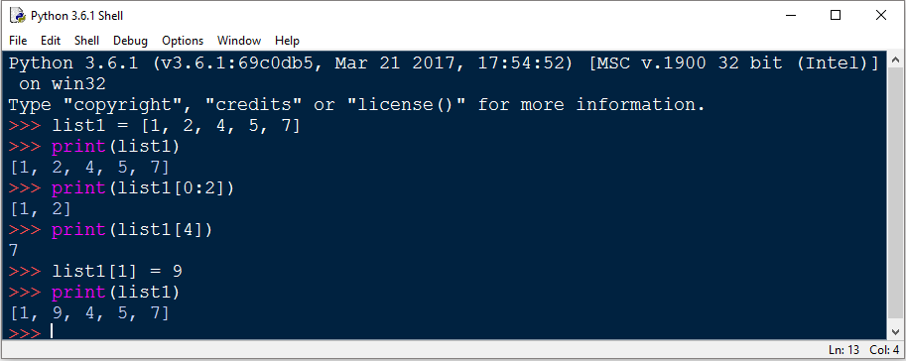
List Slicing
A subpart of list can be retrieved on the base of index. The subpart is known as list slice.

Slide 16
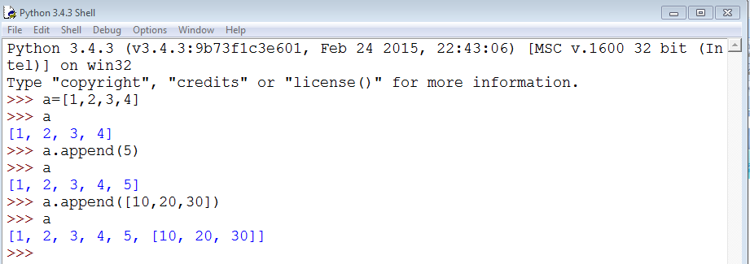
List Methods
Append (): The append () method adds a single item to the existing list. It doesn’t return a new list.
Syntax: list.append (item)

Slide 17
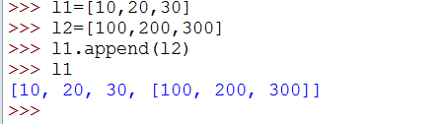
Adding two Lists
Adding list to a list: It is nothing but we have to take two lists i.e., animal and wild_animal. Now some elements are append from one list to another list let us see in below example

Slide 18
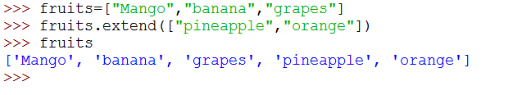
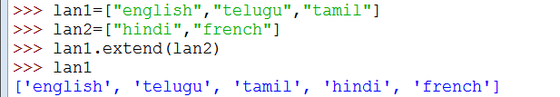
Extend
The extend () method takes a single argument (a list) and adds it to the end
list.extend(list2)
Here, the elements of list2 are added to the end of list1

Slide 19
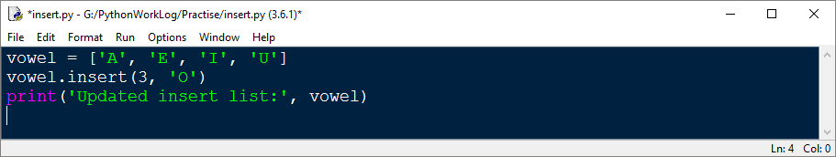
INSERT
This method takes two parameters
Index – position where elements needs to be inserted
Elements – this is the elements to be inserted in the list
Syntax:
list.insert (index, element)

Slide 20
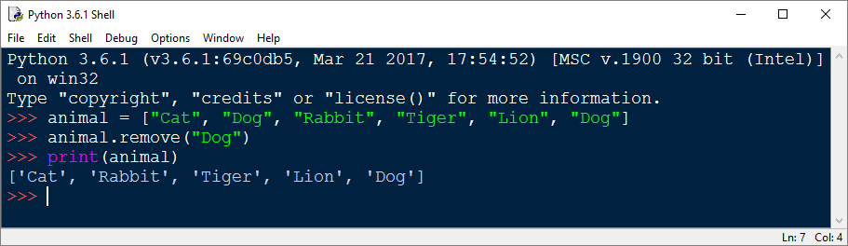
Remove
The remove () method takes a single element as an argument and removes it from the list. It does not return any value.
Syntax: list.remove (element)

Slide 21
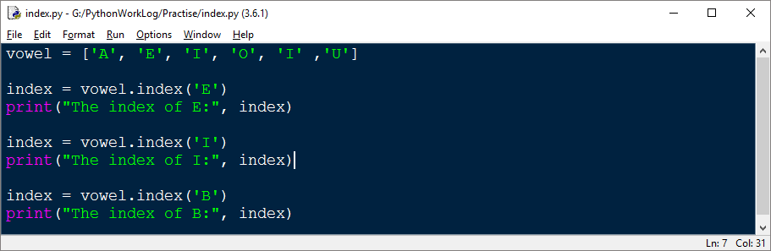
Index
index () :method finds the given elements in a list and returns its position. However, if the same element is present more than once, index () method returns its smallest/first position.
Syntax: list.index (element)

Slide 22
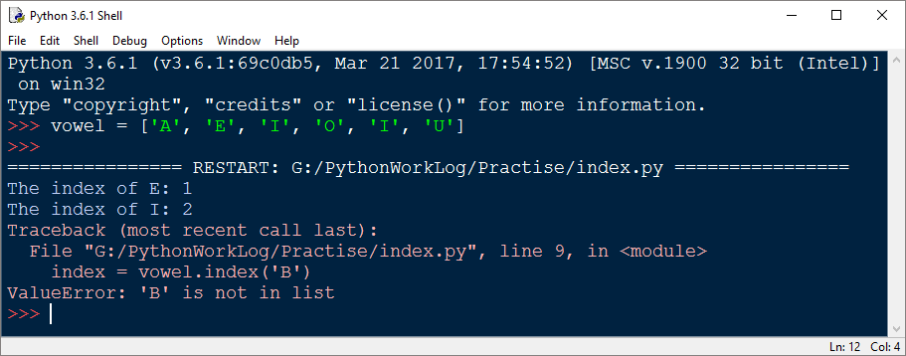
Continue….
The index () method returns the index of the element in the list. If not found, it raises a ValueError exception indicating the element is not in the list.

Slide 23
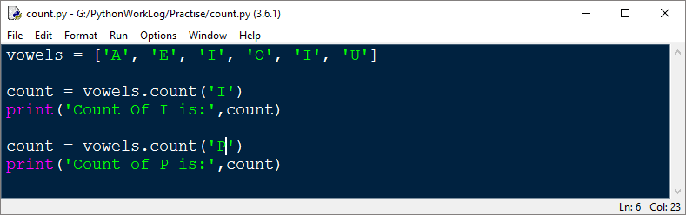

Count
Count () method count how many times an element has occurred in a list and returns it count.
Syntax: list.count(element)

Slide 24
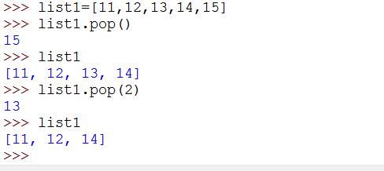
Pop
The pop () method takes a single argument (index) and removes the element present at that index from the list
If no parameter is passed, the default index -1 is passed as an argument which returns the last element.

Slide 25
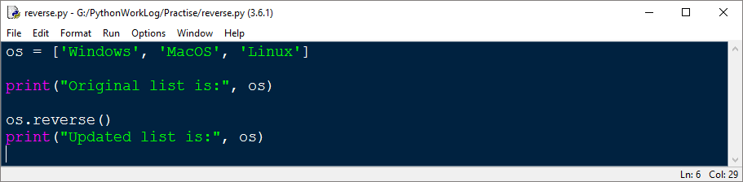
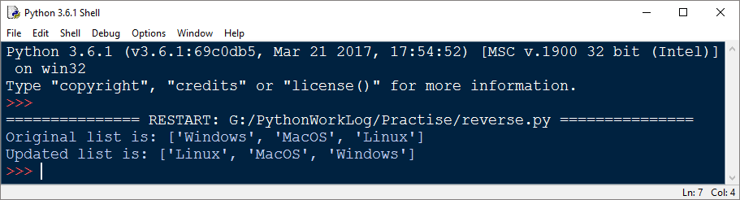
Reverse
The reverse () function doesn't return any value. It only reverses the elements and updates the list
Syntax: list.reverse ()

Slide 26
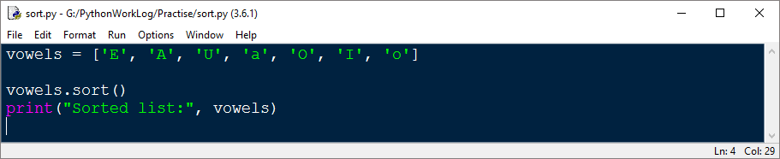
Sort
The sort () method sorts the elements of a given list in a specific order Ascending or Descending.
Syntax: list.sort (key= …, reverse= ….)

Slide 27
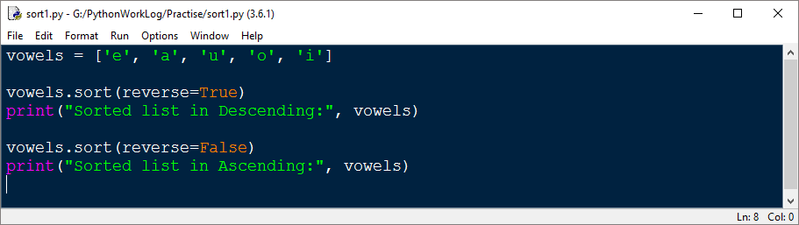
How to sort in descending order?
Sort () method accepts a reverse parameter as an optional argument
Syntax:list.sort (reverse=True)

Slide 28
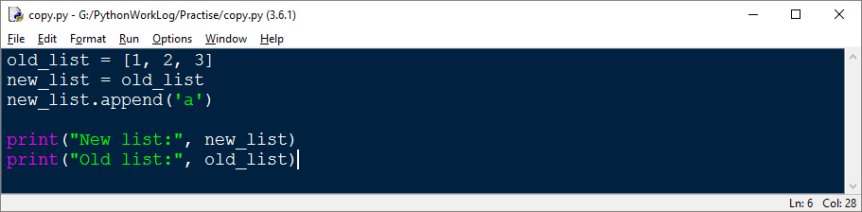

Copy
The problem with copying the list in this way is that if modify the new list, the old list is also modified
Syntax: new_list = old_list

Slide 29
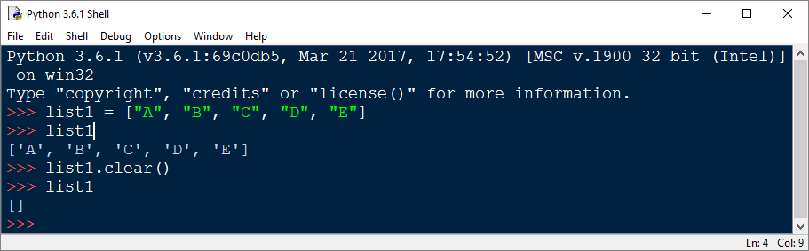
Clear
The clear () method only empties the given list doesn’t take any parameters
Syntax: list.clear ()

Slide 30

Deleting Elements
Deleting multiple items from a list is not directly possible in one command in python.

Slide 31
Lambda function
Anonymous function is a function that is defined without a name.
Normal functions are defined using the def keyword and Python anonymous functions are defined using the lambda keyword.
Lambda Syntax: lambda arguments: expression
Lambda functions can have any number of arguments but only one expression. The expression is evaluated and returned. Lambda functions can be used wherever function objects are required.

Slide 32
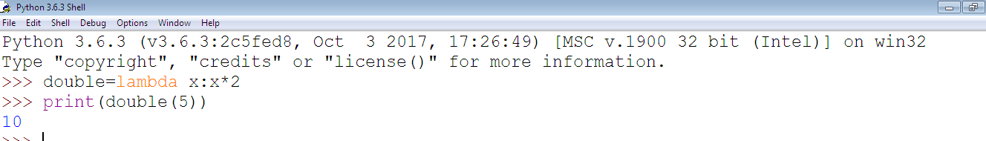
Example
In the above program, lambda x: x * 2 is the lambda function. Here x is the argument and x * 2 is the expression that gets evaluated and returned

Slide 33

Map
The map () function applies a given to function to each item of an iterable and returns a list of the results.
Example 2

Slide 34
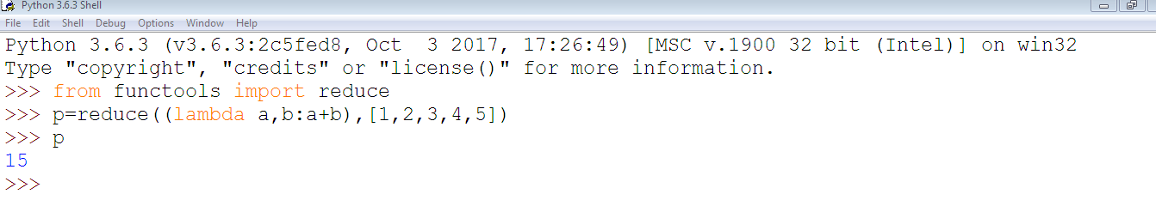
Reduce
Reduce is a really useful function for performing some computation on a list and returning the result. It applies a rolling computation to sequential pairs of values in a list.

Slide 35
Filter
The filter() method constructs an iterator from elements of an iterable for which a function returns true
the filter() method filters the given iterable with the help of a function that tests each element in the iterable to be true or not
The syntax of filter() method is:
filter(function, iterable)

Slide 36
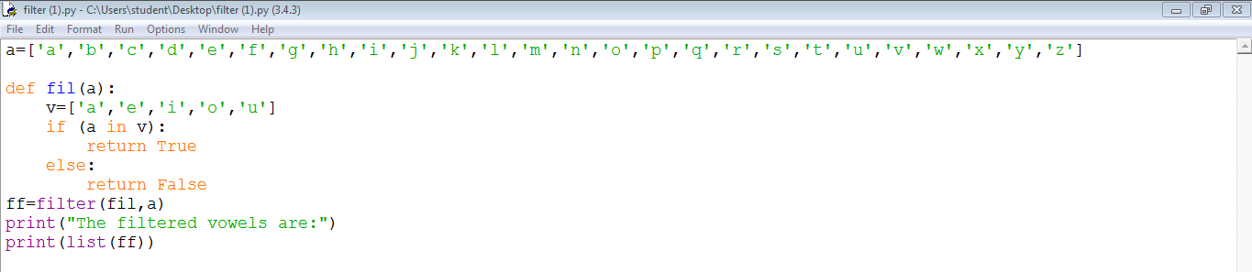
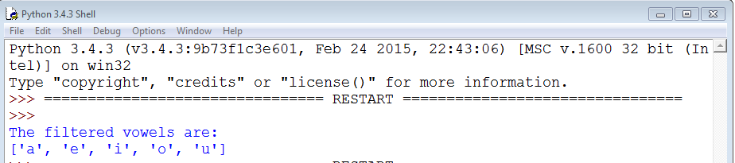
Example

Slide 37
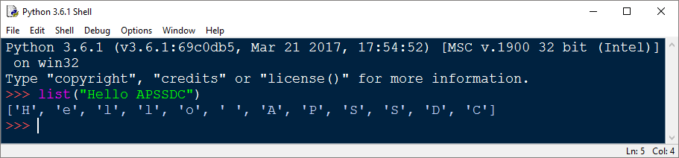
Lists and Strings
Python has several tools which combine lists of strings into strings and separate strings into lists of strings.
The list command takes a sequence type as an argument and creates a list out of its elements. When applied to a string, you get a list of characters

Slide 38
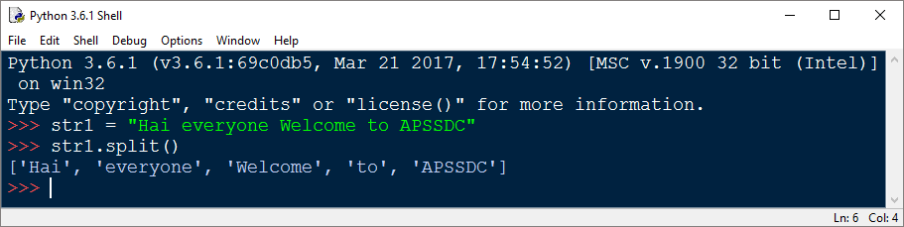
Split
The split method invoked on a string and separates the string into a list of strings, breaking it apart whenever a substring called the delimiter occurs. The default delimiter is whitespace, which includes spaces, tabs, and newlines

Slide 39
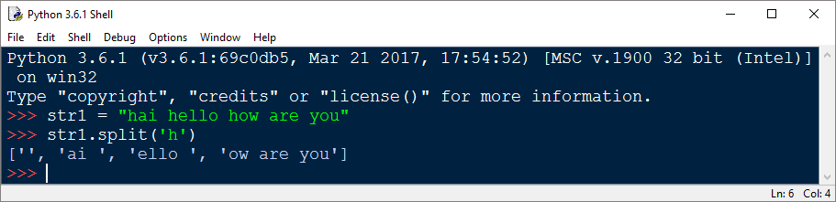
Continue…
Here we have 'h' as the delimiter
Notice that the delimiter doesn’t appear in the list. The join method does approximately the opposite of the split method

Slide 40
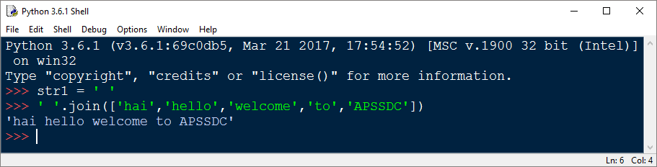
Join
It takes a list of strings as an argument and returns a string of all the list elements joined together

Slide 41
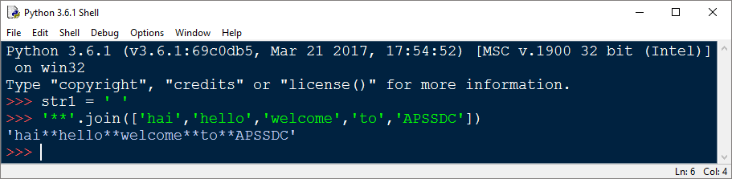
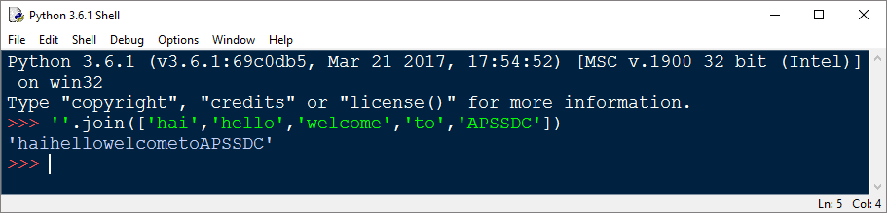
Continue…..
The string value on which the join method is invoked acts as a separator that gets placed between each element in the list in the returned string.
The separator can also be the empty string

